Slide 1
Polymorphishm

Slide 2
Polymorphism
Refers to ‘one name having many forms’, ‘one interface doing multiple actions’.
In C++, polymorphism can be either
static polymorphism or
dynamic polymorphism.
C++ implements static polymorphism through
overloaded functions
overloaded operators

Slide 3
Overloading
Overloading – A name having two or more distinct meanings
Overloaded function - a function having more than one distinct meanings
Overloaded operator - When two or more distinct meanings are defined for an operator

Slide 4
Function overloading
Using the concepts of function overloading , a family of functions with one function name but with different argument lists in the functions call .The correct function to be invoked is determined by checking the number and type of the arguments but not on the function type.

Slide 5
example
//Declaration
int add(int a, int b); //prototype 1
int add (int a, int b, int c); //prototype 2
double add(double x, double y); //prototype 3

Slide 6
Signature of a Function
A function’s argument list (i.e., number and type of argument) is known as the function’s signature.
Functions with Same signature - Two functions with same number and types of arguments in same order
variable names doesn’t matter. For instance, following two functions have same signature.
void squar (int a, float b); //function 1
void squar (int x, float y);

Slide 7
Resolution by Compiler when it sees second function with same name
Signature of subsequent functions match previous function’s, then the second is treated as a re-declaration of the first - Error
Signatures of two functions match exactly but the return type differ, then the second declaration is treated as an erroneous re-declaration of the first
For example,
float square (float f);
double square (float x);
// Differ only by return type so erroneous re-declaration
//error

Slide 8
If the signature of the two functions differ in either the number or type of their arguments, the two functions are considered to be overloaded.

Slide 9
CALLING OVERLOADED FUNCTIONS
Overloaded functions are called just like other functions. The number and type of arguments determine which function should be invoked.
For instance consider the following code fragment:
//function call
cout<<add(5,10); //uses prototype 1
cout<<add(5,10,15); //uses prototype 2
cout<<add(12.5,7.5); //uses prototype 3

Slide 10
Steps Involved in Finding the Best Match for a function call
A call to an overloaded function is resolved to a particular instance of the function, there are three possible cases, a function call may result in:
Exact match - A match is found for the function call.
No match - No match is found for the function call.
Ambiguous Match - More than one defined instance for the function call.

Slide 11
1. Exact Match
For example, there are two functions with same name afunc:
void afunc(int);
void afunc(double);
The function call
afunc(10);
is matched to void afunc(int); and compiler invokes corresponding function definition
as 10 is of type int
//overloaded functions
//exactly match. Matches afunc(int)

Slide 12
2. A match through promotion
If no exact match is found, an attempt is made to achieve a match through promotion of the actual argument.
Recall that the conversion of integer types (char, short, int) into int - integral promotion.
float to double

Slide 13
For example, consider the following code fragment:
void afunc (int);
void afunc (float);
afunc (‘c’);
Will invoke afunc(int)
//match through the promotion; matches afunc (int)

Slide 14
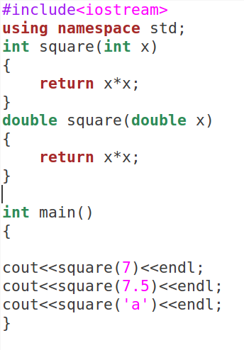
Compiler resolves square (‘a’) to square(int)

Slide 15
3. standard conversion
If no promotion is possible, C++ tries to find a match through standard conversion.
Any numeric type will match any other numeric type.

Slide 16
example
struct Employee; // defined somewhere else
void print(float value);
void print(Employee value);
print('a'); // 'a' converted to match print(float)
In this case, because there is no print(char) (exact match), and no print(int) (promotion match), the ‘a’ is converted to a float and matched with print(float).

Slide 17
If the conversion is possible to have multiple matches, then the compiler will give error message.
Example:
long square (long n);
double square(double x);
A function call such as :- square(10)
Will cause an error because int argument can be converted to either long or double .There by creating an ambiguous situation as to which version of square( )should be used.

Slide 18
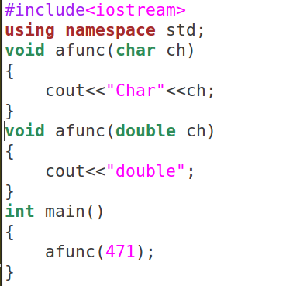
Error ambiguous call

Slide 19
Finding Gross Pay
Three are three types of employees in Indian railways. They are regular, daily wages and consolidated employees. Gross Pay for the employees are calculated as follows:
regular employees - basic + hra + % of DA * basic
Daily wages – wages per hour * number of hours
Consolidated – fixed amount

Slide 20
PAC - Finding Gross pay
Input | Output | Logic Involved
Components for calculating gross pay | Gross pay | Based on type of employees – Calculate gross pay

Slide 21
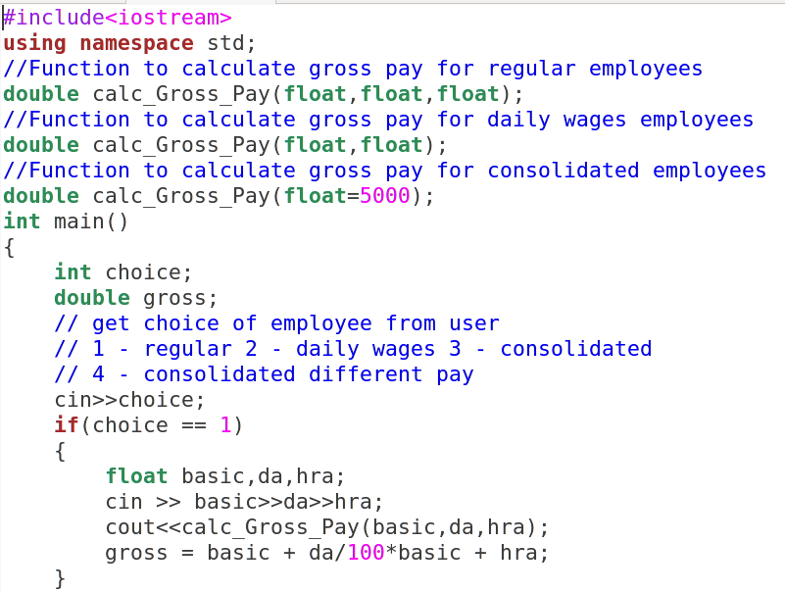

Slide 22
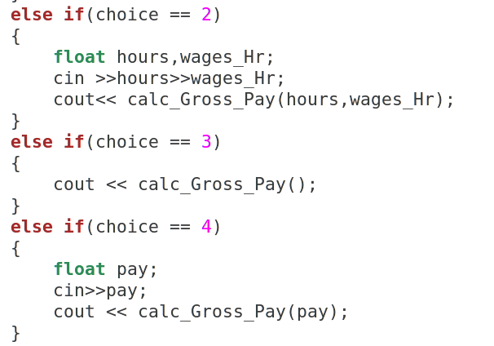

Slide 23
